Slide 1

Speech Emotion Recognition
Comparing modern methods of Machine learning for classification of human emotion from speech samples

Slide 2

What is Speech Emotion Recognition?
When you’re having a conversation with your best friend, you can typically identify if your friend is frustrated, happy or angry from how they sound.
With the advent of digital personal assistants and speech-to-text software, speech emotion recognition is still in its infancy and has many applications.
While most humans can accomplish this task with ease, it’s a bit more challenging for software.

Slide 3
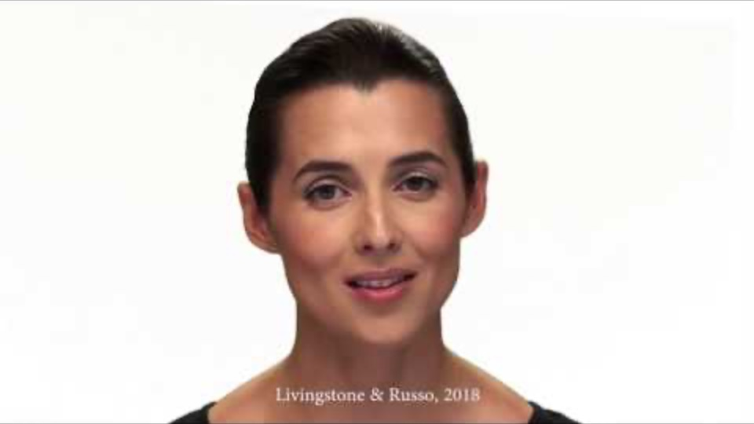
Data Source: The Ryerson Audio-Visual Database of Emotional Speech and Song (RAVDESS)
24 actors
8 emotions
2 statements
‘Dogs are sitting by the door’
‘Kids are talking by the door’
2 intensities
Strong
Normal
2 vocal channels
Speech
Song
https://zenodo.org/record/1188976

Slide 4

Problem Statement:
A Speech Emotion Recognition (SER) model allows a program to correctly identify the emotional state of a speaker. The community of data scientists working on the SER problem is currently split between two main methodolgies-- using sound data transformations and using spectrogram arrays as image data with a convolutional neural network. This project's purpose is to examine the two methodologies and determine which is more suited for adaptation to working with real-time speech emotion classification instead of pre-existing samples.

Slide 5
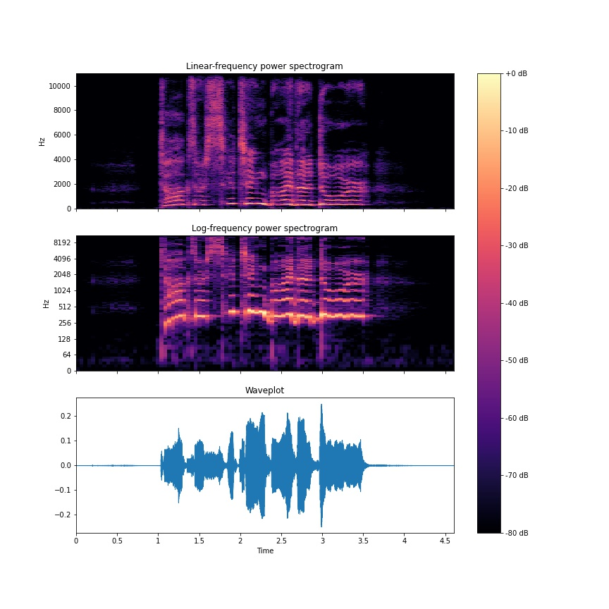
How to Visualize Sound Data
Linear Frequency Power Spectrogram
Log Frequency Power Spectrogram
Waveplot

Slide 6
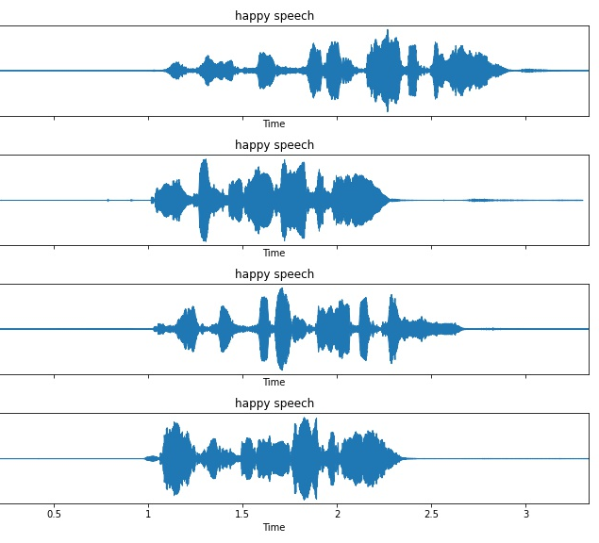
Waveforms by Vocal Channel
1. Each word shows up as a distinct spike in the time intervals, whether its in speech or song.
2. There is an immediately visible difference in the amplitude of the pattern for two of the speeches. This is most likely the 'low' and 'high' intensities.

Slide 7
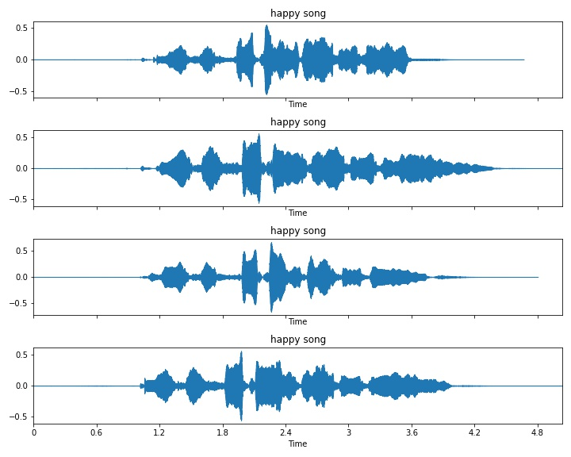
Waveforms by Vocal Channel - Song
1. We’re still seeing each word as a separate spike in amplitude
2. We’re still seeing two variations in overall amplitude.
3. When adding song files to the mix we’re also seeing that the song samples are slightly longer than the speech samples.

Slide 8
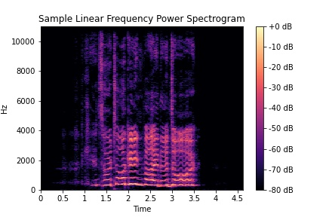
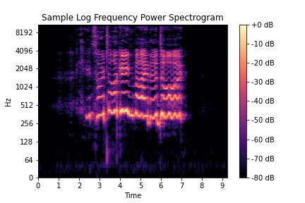
Spectrograms!
Linear Frequency Power Spectrogram
Log Frequency Power Spectrogram

Slide 9
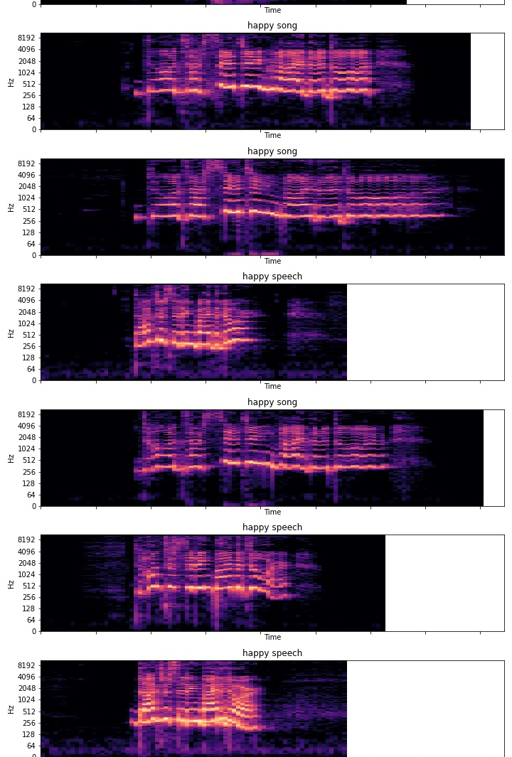
Happy Log Spectrograms
A side by side look at the log frequency power spectrograms of all ‘happy’ samples

Slide 10
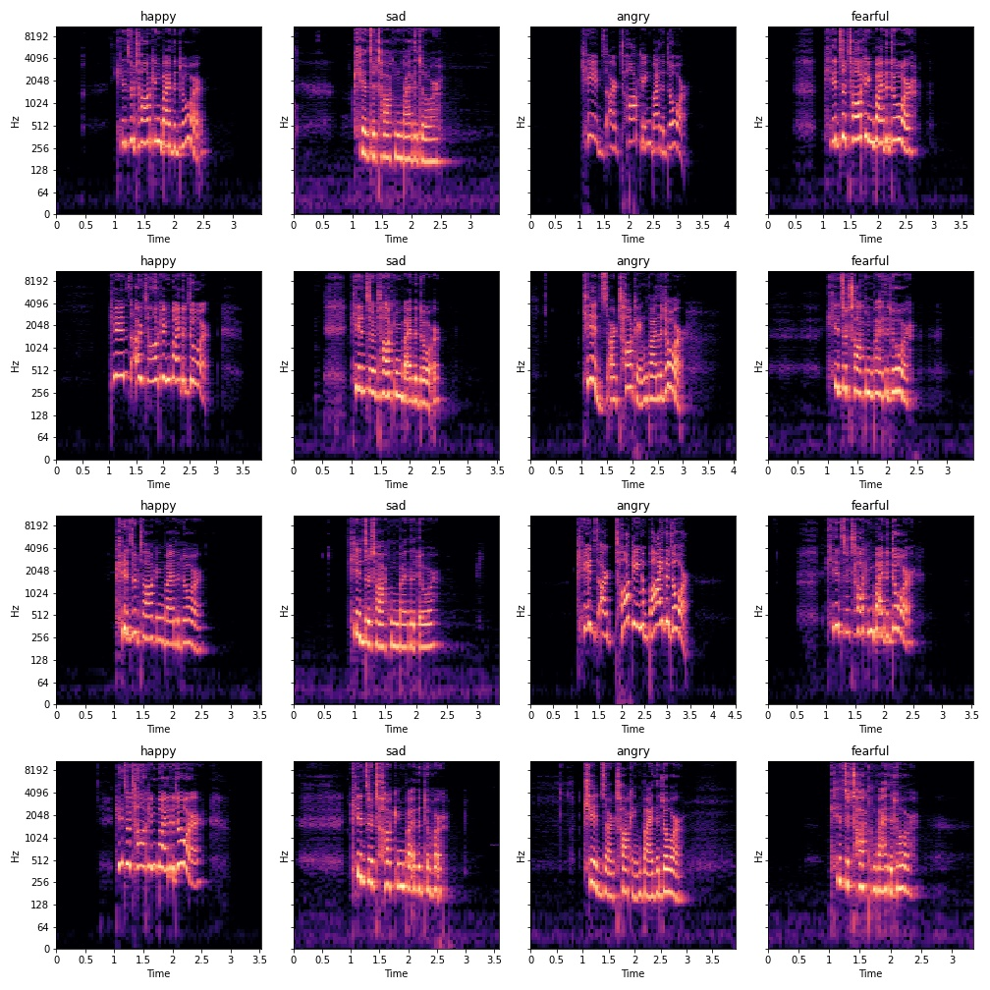
‘Big Four’ Emotions
4 Emotions are present in both speech and song samples- ‘Happy’ ‘angry’ ‘sad’ and ‘fearful

Slide 11
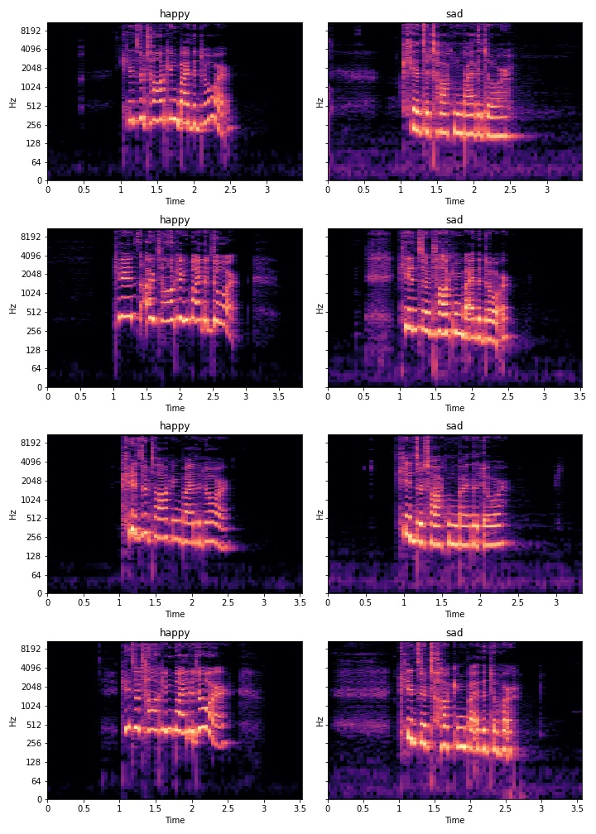
Once we start to compare log-frequency power spectrograms by emotions, I can see trends start to emerge

Slide 12
Can you Spot the Pattern?
looking at the log frequency spectrograms lends credence to the theory of using an image transformation for the model.

Slide 13
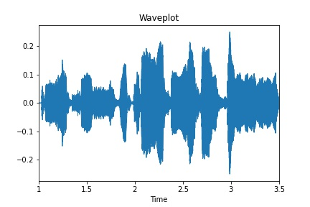
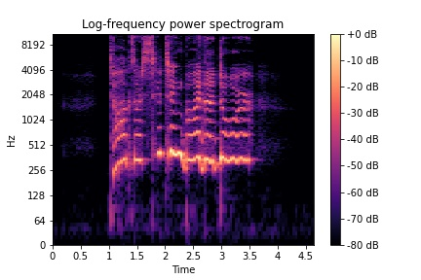
So How do we model this?
Flat Model:
3 Different Transformations: MFCC, CHROMA, and MELSPECTROGRAM transforms.
A 6 second waveform sampled 101, 532 times
The Mel-Frequency Cepstrum Coefficients are obtained by:
Take a Fourier Transform of the sample
Map the results to the Mel scale
Log the powers at each Mel frequency (flexible)
Take a discrete cosine transform of each item of the Mel log powers
Sample the amplitudes of the resulting spectrum
Becomes an array of 40 by 275
There’s a lot to it, it’s okay if this takes a bit to understand. I recommend checking out:
https://jackschaedler.github.io/circles-sines-signals/index.html

Slide 14
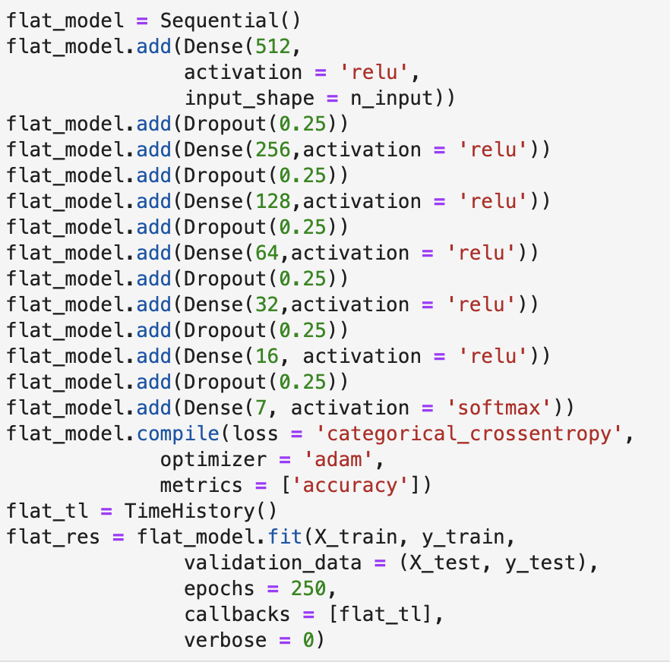
Flattened Features
Each sample in the flattened array condenses the 101,532 time slice samples into a sequence of 180 weighted features
This compromises the time series nature of a waveform.

Slide 15
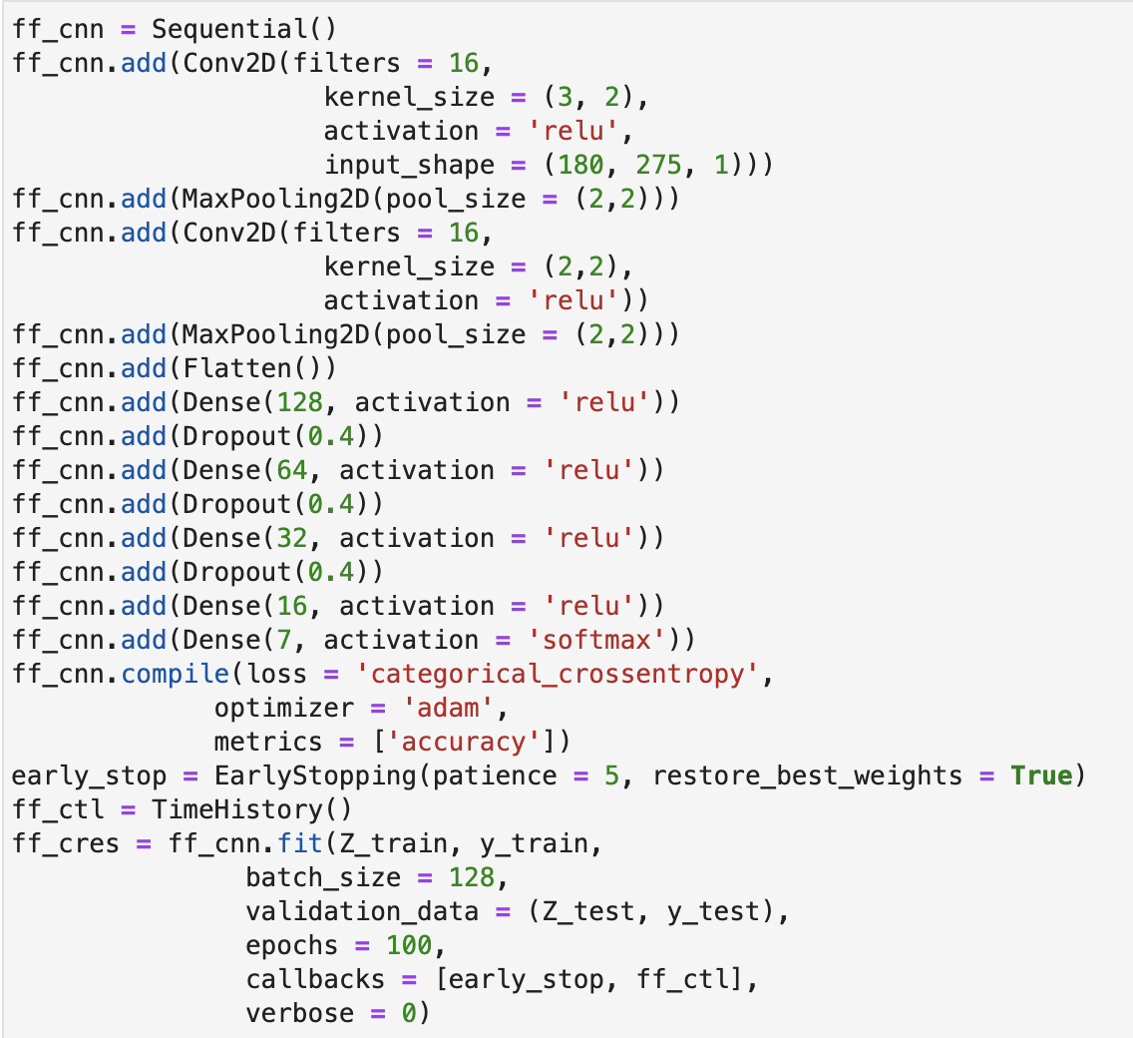
Full Feature Array
Using the full feature array of transformations takes the same 101,532 time sample slices and transforms it into a 180 by 275 array.
This method maintains the time series information by stacking the transformations vertically, and the wave form can be reconstituted from the array.

Slide 16
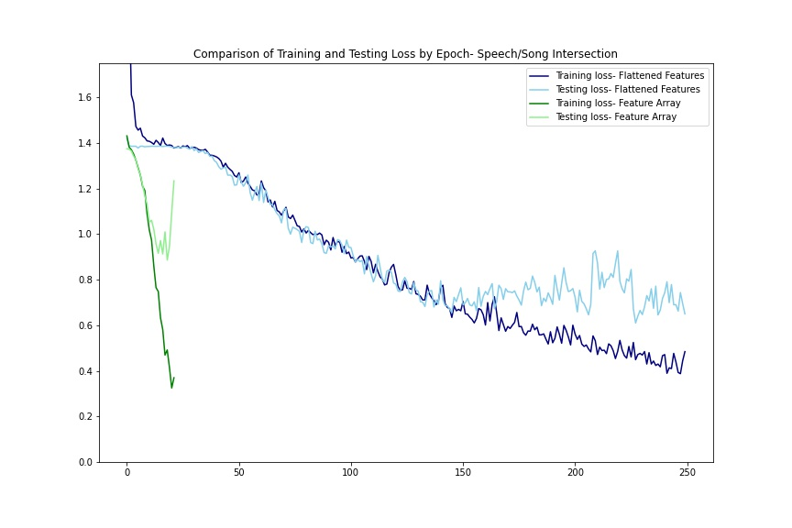
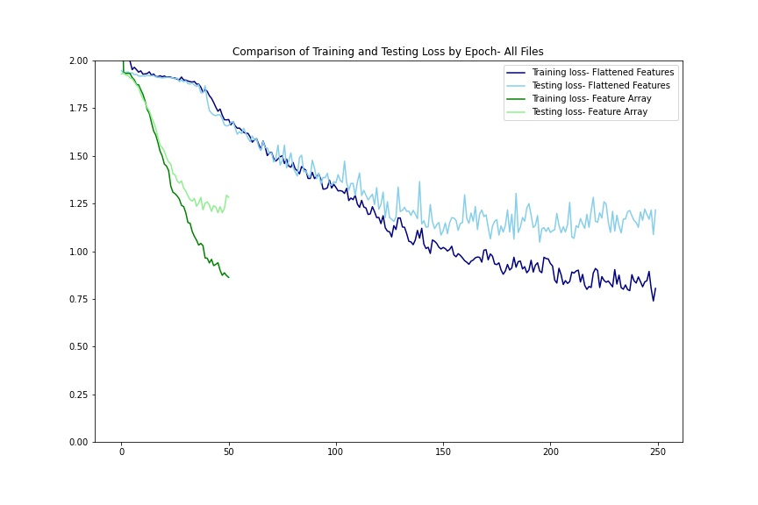
Comparing Methodologies: Training/Testing Loss by epoch

Slide 17
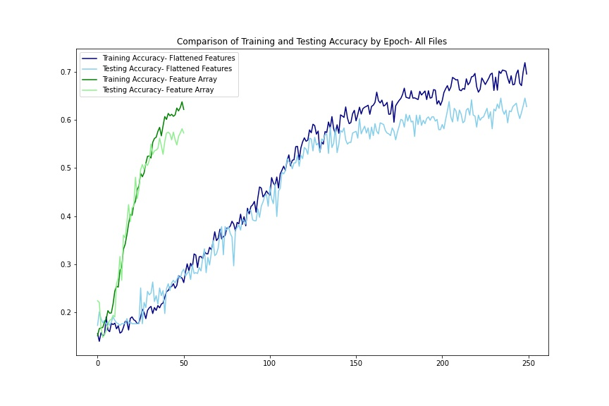
Train/Test Accuracy by Epoch
We’re starting to see a pattern here. When we’ve compared the loss across methodologies we’ve previously seen that it takes far fewer epochs to reach a smaller loss for the convolutional neural network which maintains a stacked array compared to the flattened feature models.
We see this same pattern with accuracy. The green lines represent the training and testing accuracy for the feature array method while the blue lines are the training and testing accuracy for the flattened feature method.

Slide 18
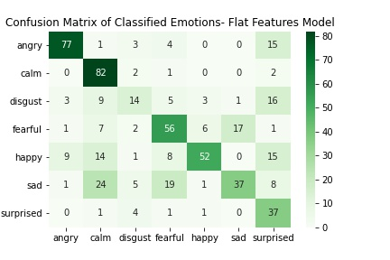
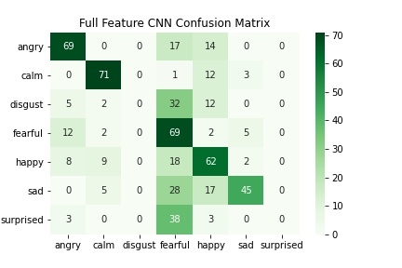
Relative Confusion Matrixes
While neither model is particularly good at handling the ‘disgust’ emotion, the flattened feature model at least gets a few correct. Interestingly, the feature array version doesn’t even try to include the two minority classes of ‘disgust’ and ‘surprise’

Slide 19
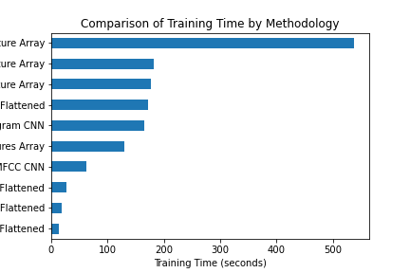
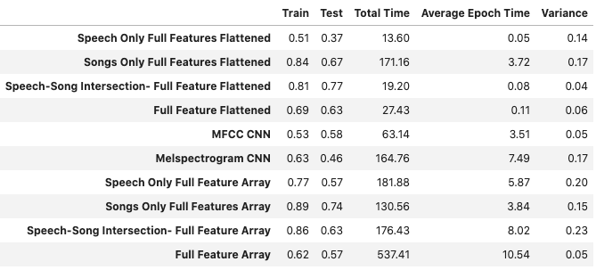
Comparison of Training and Testing Accuracy with Total Time
1. When we narrow down the dataset to only classify the emotions for which we have both speech and song samples, we see an increase in the training accuracy of 10-20%. This is true across both the flattened features and the feature array methods.
2. The full feature array takes longer to fit. Apart from the songs only test run, the training time of the flattened feature models was below 30 seconds, while the training time of the feature array models was 63 seconds at best.

Slide 20
Conclusions:
Problem statement:
Which of the two most common SER methodologies is better suited for adaptation to real – time sound processing?
Analysis:
The full feature array method which looks at spectrograms as image data is comparably effective to the flattened feature method and takes 20 times as long, despite using fewer iterations. The flattened feature method is both faster and more accurate, therefore it is more suited to adaptation to real-time SER classification.

Slide 21
Recommendations for Further Research
The RAVDESS dataset has some limitations:
it is designed for clinical testing in that it only uses a ‘Neutral North American’ accent
It only uses two specific near identical statements ‘Kids are talking by the door’ and ‘Dogs are sitting by the door’
Despite including roughly 2.2 thousand samples, each emotion shows up AT MOST 376 times
In short: we need more data, both in sheer volume and in variety. If the goal of speech emotion recognition is to reach beyond the academic, the model needs to be able to accurately predict the emotions of a broader audience.

Slide 22
Acknowledgements
Livingstone SR, Russo FA (2018) The Ryerson Audio-Visual Database of Emotional Speech and Song (RAVDESS): A dynamic, multimodal set of facial and vocal expressions in North American English. PLoS ONE 13(5): e0196391. https://doi.org/10.1371/journal.pone.0196391.
EDA Segment and comprehension of the Short Term Fuorier Transform inspired by
https://jackschaedler.github.io/circles-sines-signals
https://www.kdnuggets.com/2017/12/audio-classifier-deep-neural-networks.html
https://github.com/lukas/ml-class/blob/master/videos/cnn-audio/audio.ipynb
Speech Intelligibility information courtesy of :
https://www.dpamicrophones.com/mic-university/facts-about-speech-intelligibility
AUTHOR=Lech Margaret, Stolar Melissa, Best Christopher, Bolia Robert
TITLE=Real-Time Speech Emotion Recognition Using a Pre-trained Image Classification Network: Effects of Bandwidth Reduction and Companding
.frontiersin.org/article/10.3389/fcomp.2020.00014
McFee, Brian, Colin Raffel, Dawen Liang, Daniel PW Ellis, Matt McVicar, Eric Battenberg, and Oriol Nieto. “librosa: Audio and music signal analysis in python.” In Proceedings of the 14th python in science conference, pp. 18-25. 2015.

